Slide 1

Data Mining & Knwlg Disc
Prediction of Lending Club Loan
Group 3
YU Yawen、CHEN Yijun、 CHEN Yanxin
Notes:
Hello everyone, we are Group 3, my name is yuyawen and my group members are chenyijun and chenyanxin. Today, we are going to introduce our final project: Prediction of Lending Club Loan.

Slide 2
01
Introduction
Prediction of
Lending Club Loan
02
EDA & Data Preprocessing
03
Model
Notes:
Our presentation is divided into the following three parts, firstly, I will give a brief introduction to our project.

Slide 3
01
Introduction

Slide 4

Introduction
low entry barriers
high flexibility
coexistence of high returns and high risks.
Lending Club is the largest global P2P lending platform.
Risk Assessment
Business Objectives
Database
Loan applicant information
1
We use a database from Kaggle that includes 27 sets of variables, including:
Repayment likelihood
Rejecting the application could result in a loss of business opportunities for the company.
Research Purpose
Loan Interest Rate; Monthly Loan Payment; Loan Term; Loan Purpose; Homeownership Status; Income Status;
Debt-to-income ratio and other variables.
2
Using EDA and machine learning to identify “default” applicants.
Default likelihood
Approving the application could lead to financial losses for the company.
Status
Applicant Status
Introduction
1
In cases where previous loan applicants have refused to repay or absconded with the funds, they are labeled as “charged off”.
Providing valuable insights for the company's risk assessment during loan approval.
Identifying the applicant defaulting on a loan will enable appropriate measures to be taken, thereby reducing financial losses.
The business problem can be solved through data-driven approaches.
Purpose
Purpose
2
Company needs to understand the driving factors behind loan defaults, specifically the key indicator variables of default.
With this knowledge, the company can conduct risk assessments when evaluating loan applications.
Notes:
Lending Club is the largest global P2P lending company based in San Francisco, which is characterized by it’s decentralized nature, low entry barriers, high flexibility, and the coexistence of high returns and high risks.
When a company receives a loan application, it must make an approval decision based on the applicant's information. This decision involves two types of risks: If the applicant is likely to repay the loan, rejecting the application could result in a loss of business opportunities for the company. If the applicant is unlikely to repay the loan and is at risk of default, approving the application could lead to financial losses.
If the high-risk loan applicants can be identified, corresponding measures can be taken, such as refusing loans, reducing the loan amount, and lending to high-risk applicants at a higher interest rate, so as to reduce financial losses.
We use a database from Kaggle that contains information about past loan applicants and whether they have defaulted. The database includes 27 sets of variables, containing: Monthly Loan Payment; Loan Term; Loan Purpose; Homeownership Status and etc.
Loans to high-risk applicants are the largest source of financial loss, in cases where loan applicants have previously refused to repay or absconded with the funds, they are labeled as “charged off.” Companies are required to conduct risk assessments when evaluating loan applications, so it is important for them to understand the driving force behind loan defaults, especially the key indicator variables of defaults.
Our research purpose is to use EDA and machine learning to identify potentially “defaulting” applicants, and providing valuable insights into a company's risk assessment during the loan approval process.
Next, my group members will introduce the Exploratory Data Analysis and our model.

Slide 5
02
EDA & Data Preprocessing
Notes:
There are many variables in the dataset used in our project. We explore the data characteristics of these variables through EDA, preliminarily judge which features are relatively important in this project, remove some features with duplicated information, and learn the data characteristics of each data, so as to lay a foundation for subsequent data processing.

Slide 6
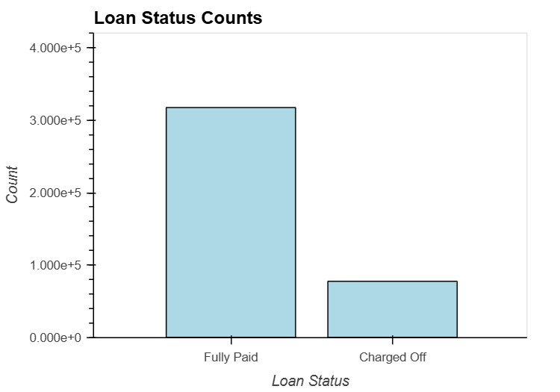

Loan status
The most important variable
The target variable
Fully paid
Charged off
EDA
Notes:
The most important variable in this project is loan status, which is also our target variable. This variable has two states, Fully paid and Charged off. As shown in the bars, there are significantly more data for fully paid than for charged off. This may be because in real life, most customers will repay the loans on time. However, this data imbalance may also have an impact on our model.

Slide 7
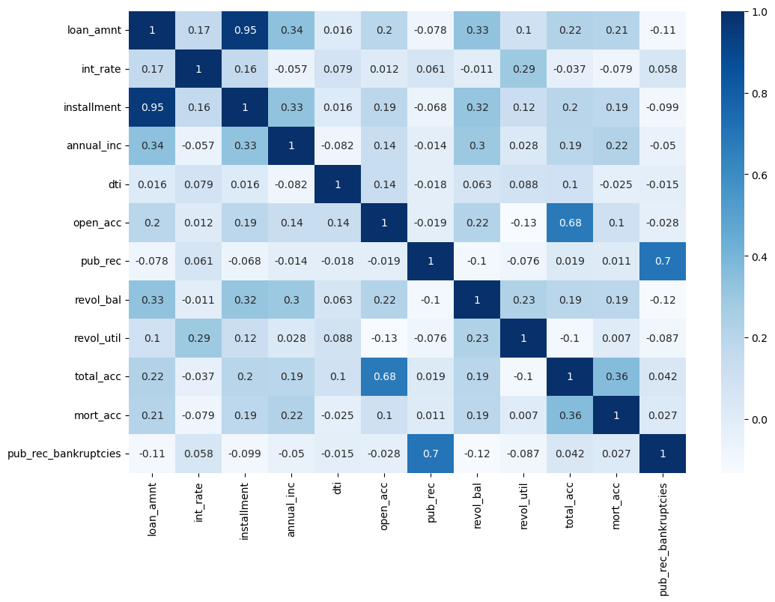
Heatmap
installment
loan amount
EDA
Notes:
We first learn the relationships between those variables through the heatmap, and it should be noted that there is a strong correlation between loan amount and installment. We will further analyze this phenomenon in a follow-up exploration and determine whether this is an important information.

Slide 8
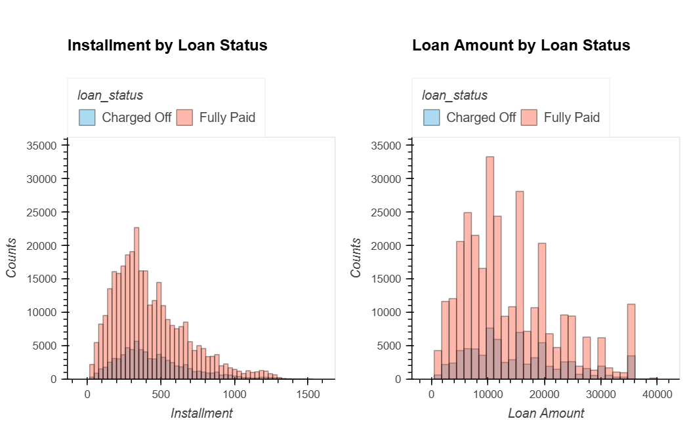
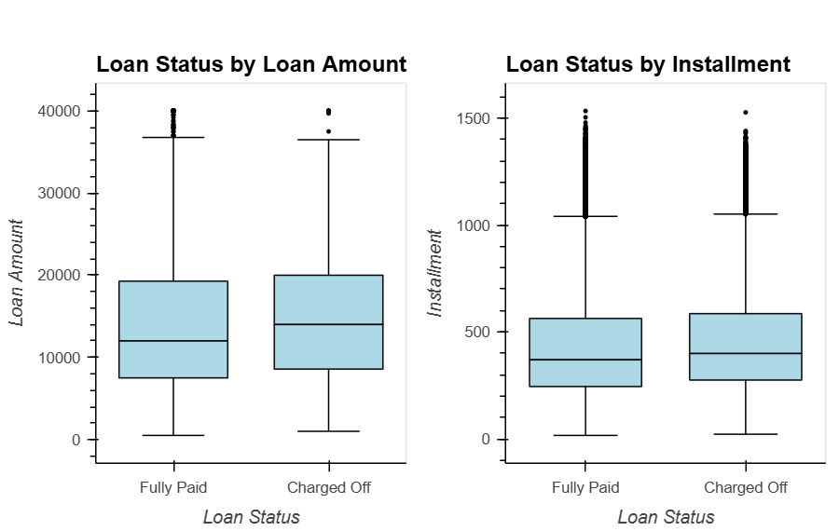
installment & loan amount
EDA
the data distribution of the two variables is very similar
the strong correlation of the two variables
Notes:
Because our target variable is loan status, all subsequent EDA was performed on the comparison of Fully paid and charged off.
lets look at the data distribution of loan_amount and installment, the loan amount is most centrally distributed in the range of 10,000-20,000, and most of the installments are concentrated between 200 and 600. It is not difficult to see that the data distribution of the two variables is very similar, which also corresponds to the strong correlation of the two variables found earlier. Since the installment amount is usually calculated based on the total loan amount, it is not difficult to explain the rationality of this correlation.

Slide 9
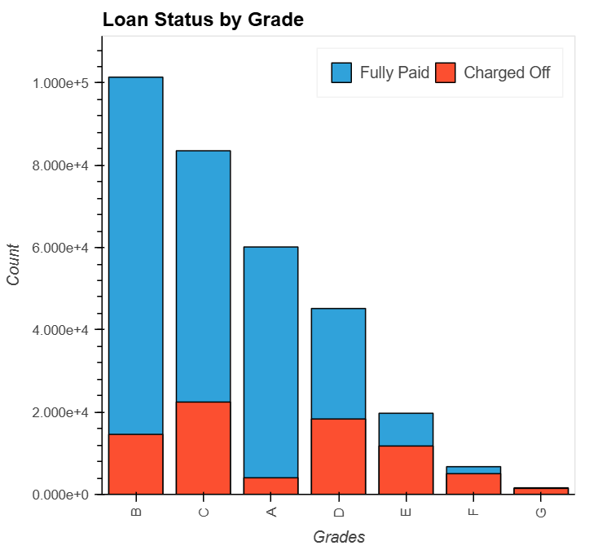
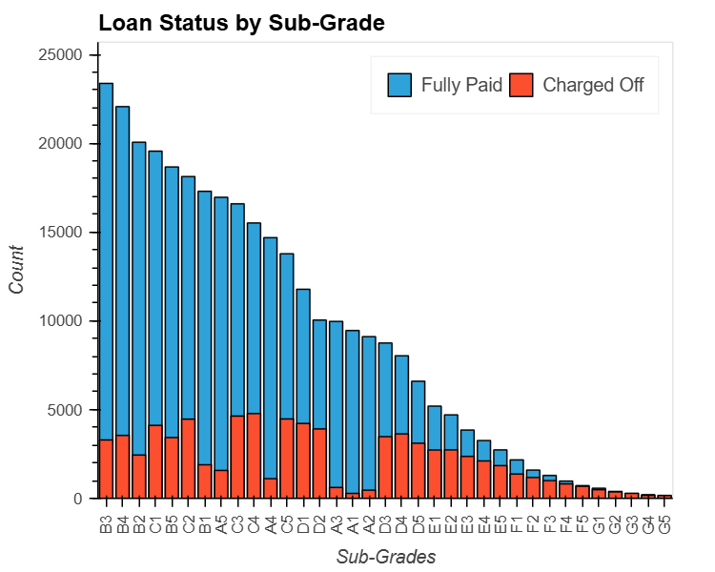
grade & sub-grade
EDA
Notes:
For customer credit grades, banks mainly focus on issuing grade B and grade C loans, which may be the best balance between risk and return. As the credit rating decreases, the proportion of defaults gradually increases. Within the same main level, the default rate also tends to increase as the secondary level number increases (such as from B1 to B5). But since the sub-grade comes with the grade subdivision, the feature grade can be removed.

Slide 10
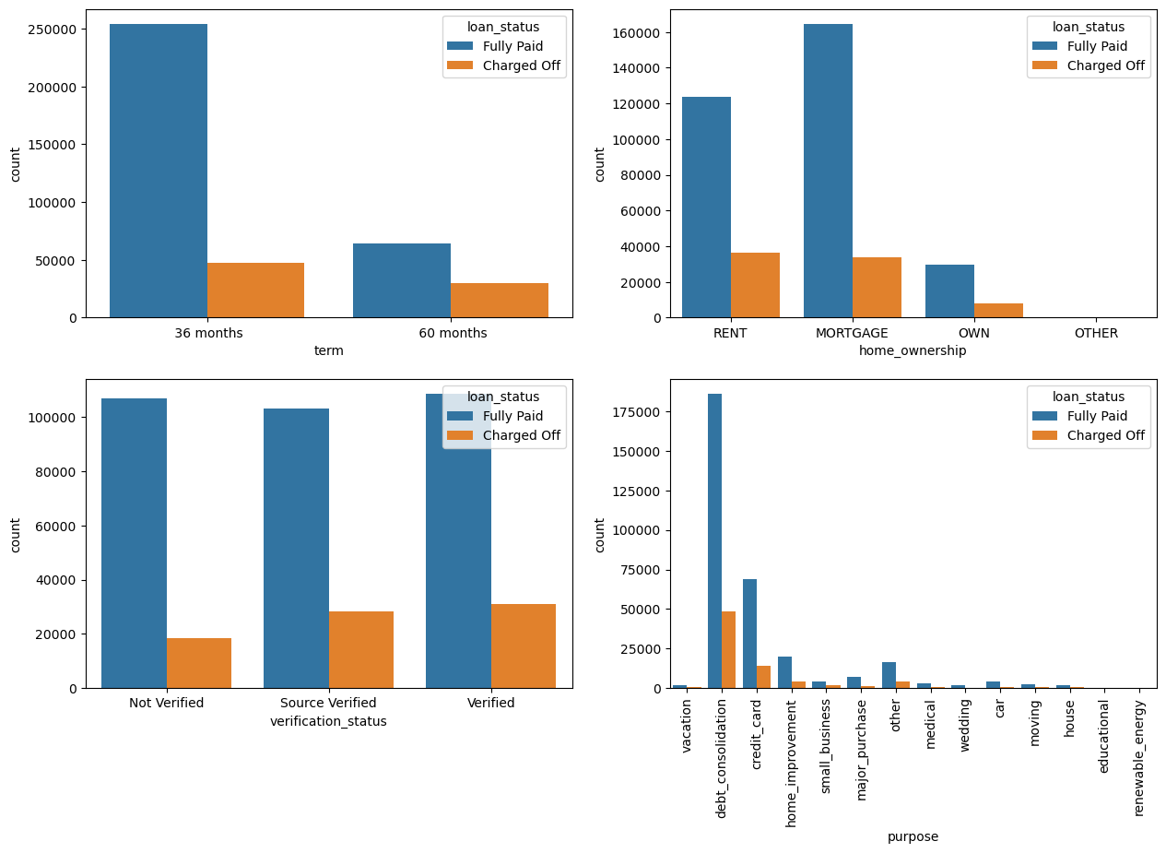
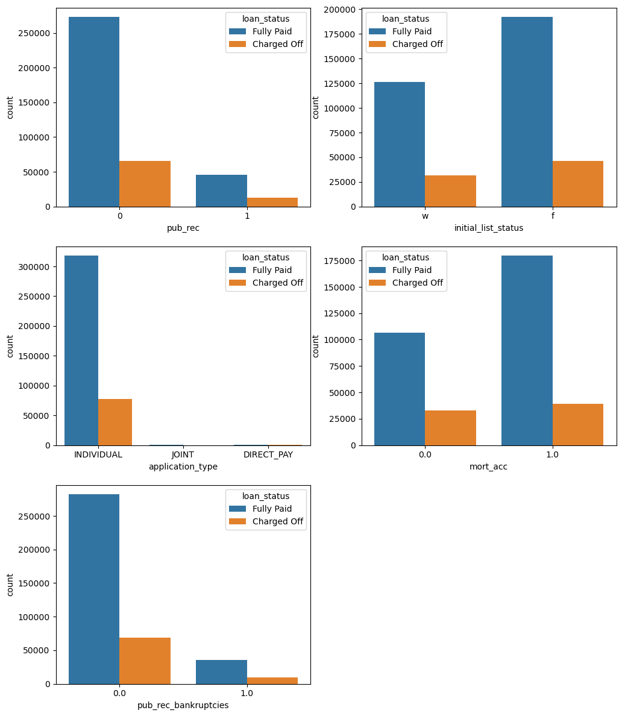
Part of other EDAs
EDA
Notes:
In this way, we also explored the data distribution of term, verification-status, purpose and so on.

Slide 11
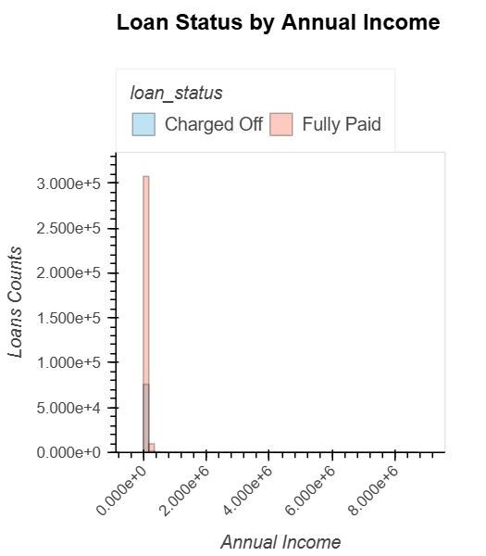
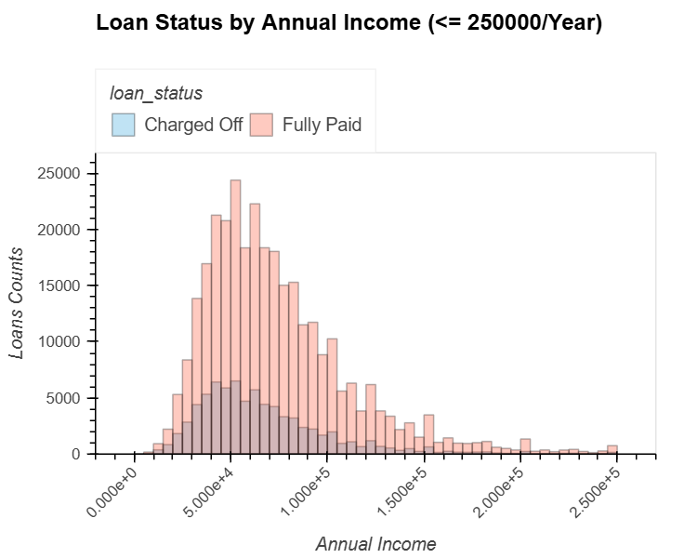

Annual Income
EDA
outliers
Notes:
When we are exploring some features, such as annual income, we found that there are extreme but precious few outliers in its distribution, we can only set a threshold to explore most of the data distribution in more detail. These thresholds are also used to eliminate outliers during subsequent data processing.

Slide 12
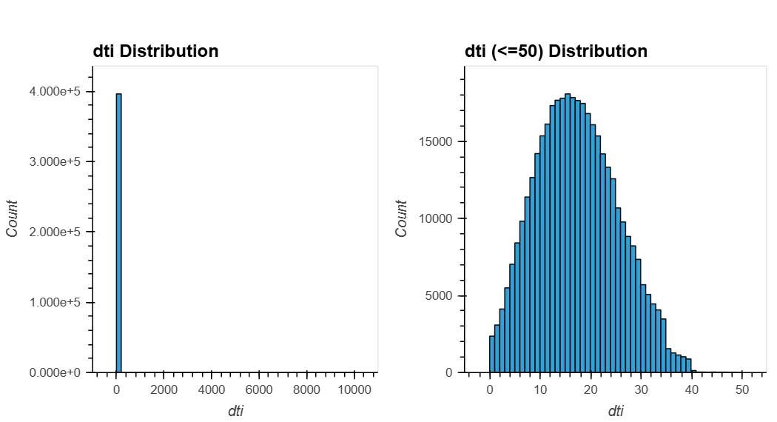
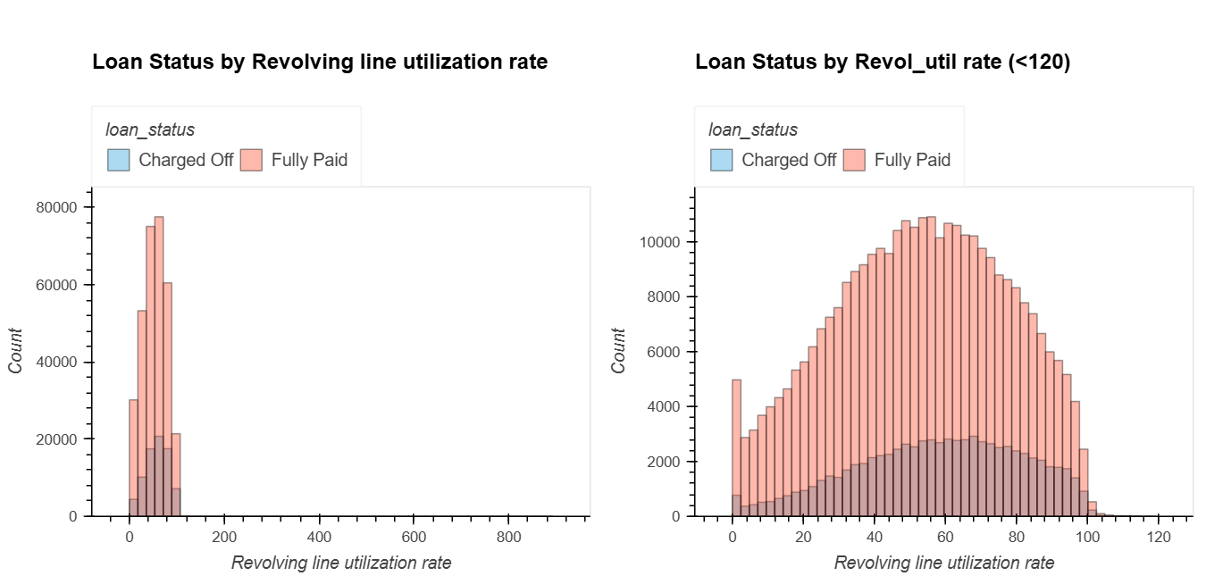
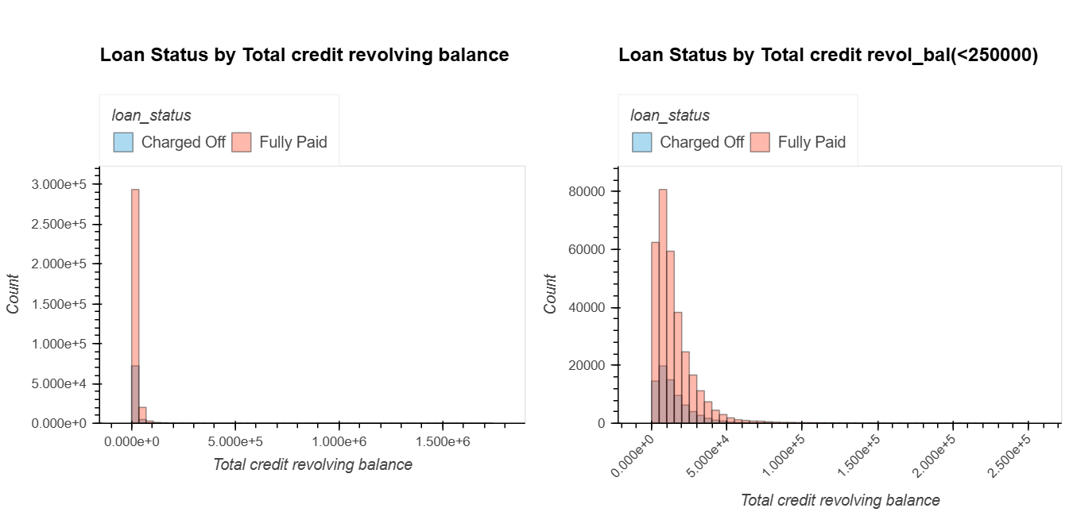
Other variables with limits
⋯
EDA
outliers
Notes:
Similarly, there are some other features with extreme outliers that require threshold limits ,like dti, Revolving line utilization rate, revolving balance.

Slide 13
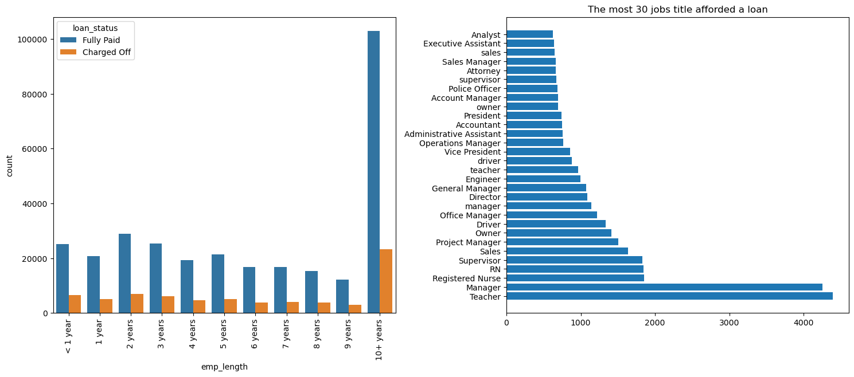
emp_length & emp_title
⋯
EDA
Notes:
For the occupation of the borrowers , the number of borrowers with more than 10 working years is the largest, and the default rate generally decreases with the increase of working years. Teacher and Manager are the two professions with the most loans. However, because the occupation types of borrowers are very complex, it loses its significance as a reference in this project, and we will remove this feature.

Slide 14
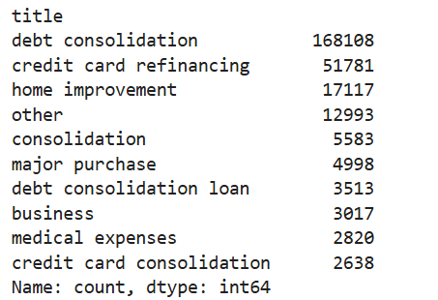
title
We already have the purpose features output according to the title, these two variables have duplication on the information.
⋯
EDA
Notes:
In addition, there are some features like the title. We already have the purpose features output according to the title, these two variables have duplication on the information, we choose to remove the title column.

Slide 15
Data Processing
NA
Encoding
Normalizing
set
dumb variables
fill in by means
unify
the scale
Introduction
Notes:
In the previous introduction, we have completed some of the data processing, including cleaning outliers and removing redundant features.
There are many missing values in the data, and the way we take to deal with the missing values is to find the variable which is related to the NA to group the missing values, and use the mean of each group to fill in the missing values in each group. Furthermore, we coded the variables with object data type as dumb variables to facilitate subsequent model building. At the same time, the data is normalized, to unify the feature scales and enhance the generalization ability of the model.

Slide 16
03
Model

Slide 17
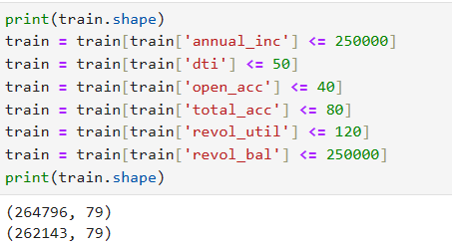
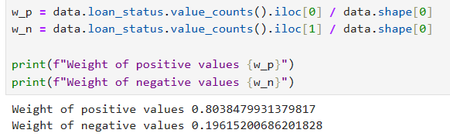
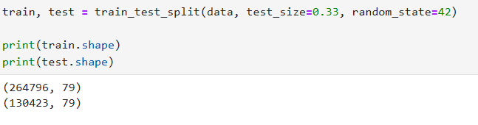
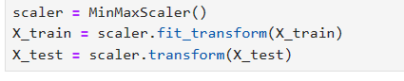
Train & test split
We first look at the distribution of both positive and negative values .
model
We can remove outliers detected by EDA part.
Finally we do the min-max normalization.
We can see that after split , the shape of train set and test set.
Notes:
Eighty percent and twenty percent It indicates that this is a inbalanced dataset.

Slide 18
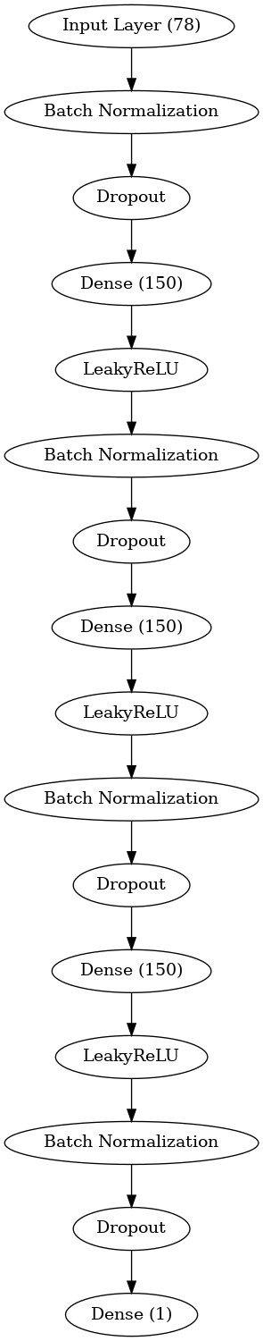
Artificial Neural Networks model
This neural network model is a multilayer perceptron (MLP) designed for binary classification tasks, specifically suited for loan default prediction. In this project, the network effectively prevents overfitting and improves training stability by using LeakyReLU activation functions, L2 regularization, dropout, and batch normalization. The output layer uses the Sigmoid activation function to output probabilities, which are used to predict whether a borrower will default. The model is trained using the Adam optimizer and binary cross-entropy loss function, with AUC as the evaluation metric to assess the model's performance at different thresholds. In the loan default prediction task, this network accurately learns from the sample features and makes reliable predictions based on borrowers' historical data, providing valuable support for Loan risk assessment.
model

Slide 19
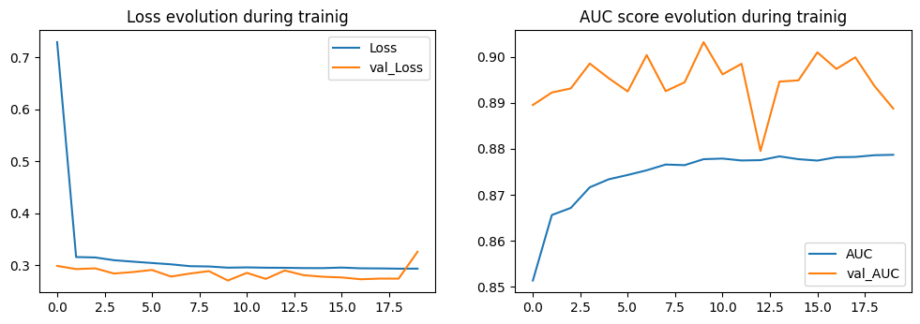
Artificial Neural Networks model
model
On the loss diagram we can see that the model achieve a low Loss after training , but may overfitting.
On the AUC diagram we can see that the model on the train is smooth , but fluctuate on validate set.

Slide 20
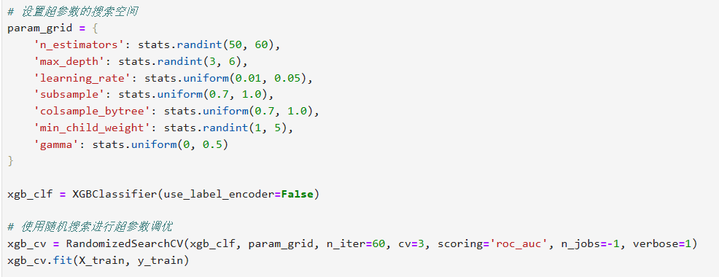
XGBoost model
XGBoost is used to predict the likelihood of loan defaults. XGBoost is a powerful gradient boosting tree model. During the model training process, we use RandomizedSearchCV for hyperparameter optimization, randomly selecting different combinations within a specified hyperparameter search space to find the best model configuration. improving the model's performance. Additionally, we enable GPU acceleration with the gpu_hist tree method, further speeding up the model's training process. Finally, we train the model with the optimized hyperparameters and evaluate its performance on both the training and test datasets.
Grid_search
model

Slide 21
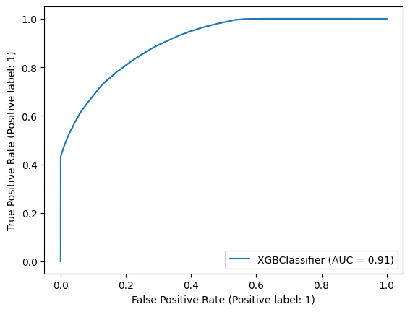
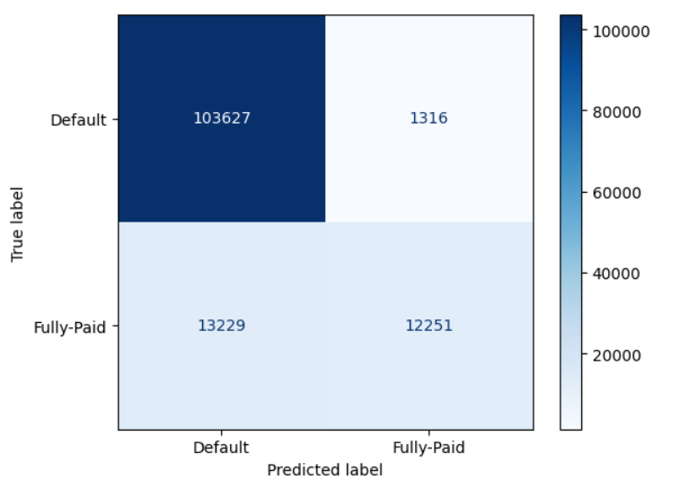
XGBoost model
Train Result:
==========================================Accuracy Score: 89.60%
Confusion Matrix:
[[208851 1627]
[ 25638 26027]]
Test Result:
==========================================Accuracy Score: 88.85%
_______________________________________________
Confusion Matrix:
[[103627 1316]
[ 13229 12251]]
model

Slide 22
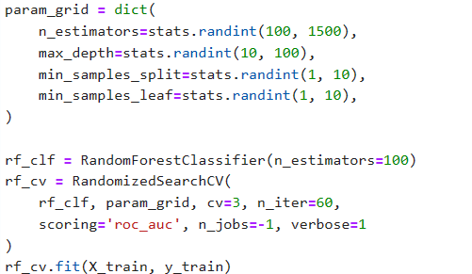
Random Forest model
Grid_search
In this project, Random Forest is used to predict loan defaults. Random Forest is an ensemble learning method that creates multiple decision trees and merges them to obtain a more accurate and stable prediction. we use RandomizedSearchCV to perform hyperparameter tuning by randomly sampling from a specified hyperparameter space. Very similar to XGBoost.
model

Slide 23
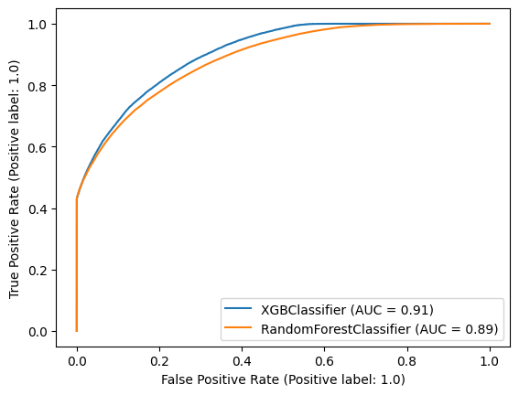
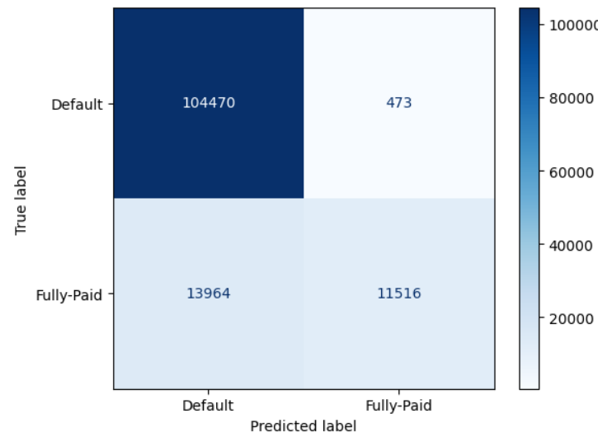
Random Forest model
Train Result:
==========================================Accuracy Score: 100.00%
_______________________________________________
Confusion Matrix:
[[210478 0]
[ 1 51664]]
Test Result:
==========================================Accuracy Score: 88.93%
_______________________________________________
Confusion Matrix:
[[104470 473]
[ 13964 11516]]
model

Slide 24
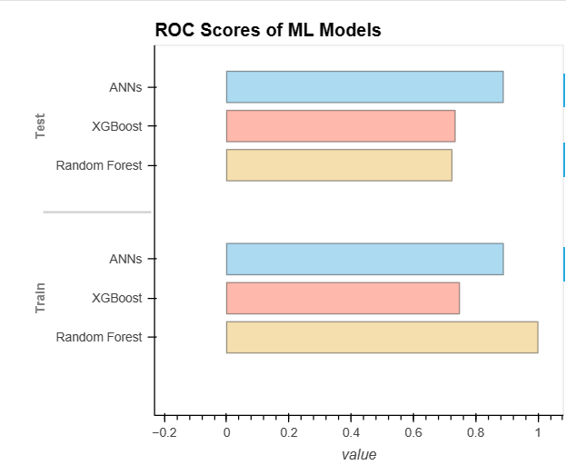
Conclusion
XGBoost underperforms on the train set, likely due to suboptimal hyperparameter tuning, but its good test set performance demonstrates its reliability and generalization capability for handling complex data.
Random Forest performs excellently on the train set but shows significant overfitting, resulting in the poorest performance on the test set.
ANNs is the best choice for this project, especially due to its superior performance on the test set, with strong generalization ability.
model
Notes:
On the train set Random Forest performs best , on the test set ANN performs best,

Slide 25
Thanks for your attention.
CHEN Yanxin、YU Yawen、CHEN Yijun

